Slide 1
1.1 Foundations of risk management
Definition of risk
Components of the risk
Types of risks
Risk management tools

Slide 2
Organizational question
Evaluation = 0.6 * Exam + 0.4 * Business cases
Exam: 1 question, oral answer + additional questions from the teacher
Business cases: 4 role play business cases based on main chapters of the course
The main source of communication: Telegram chat. Teacher’s TG -> @DS240, also pls add 2nd teachers @spaghettimafiayo and @troitskyyy
The materials and lectures in English, if you wish you can ask question in Russian

Slide 3
Topics which will be covered during course
Foundations of banking and risk
Credit risk
Market risk of trading book
Liquidity risk
Interest rate of banking book
Currency risk
Operational risk
ESG risk
Banking failures (recap + extension)
Stress testing and business planning

Slide 4


Main idea of the course: Risk management from Business standpoint
What is the aim of any business? (incl. banking business)
To maximize shareholders value in long-term period
$\frac{Revenue − Costs}{Invested capital}$ = Return on Equity (ROE)
$$\frac{Money recieved−Money Paid or Lost}{Money invested}$$

Slide 5
Definition of risk (1/2)
The International Organization for Standardization (ISO) Guide 73 provides basic vocabulary to develop common understanding on risk management concepts and terms across different applications. ISO Guide 73:2009 defines risk as:
effect of uncertainty on objectives
Note 2: Objectives can have different aspects (such as financial, health and safety, and environmental goals) and can apply at different levels (such as strategic, organization-wide, project, product and process).
Note 4: Risk is often expressed in terms of a combination of the consequences of an event (including changes in circumstances) and the associated likelihood of occurrence.

Slide 6
Definition of risk (2/2)
effect of uncertainty on objectives
If car producer detects a flaw in a safety system and decide to buy back sold cars, car producer doesn't have a risk, it has a loss
If car producer detects a flaw in a safety system and decide to conceal it, car producer is exposed to Reputation and Legal risk (known risk)
If car producer doesn’t detect any flaws in the safety system, car producer is still exposed to risk that it may exists (unknown risk)

Slide 7
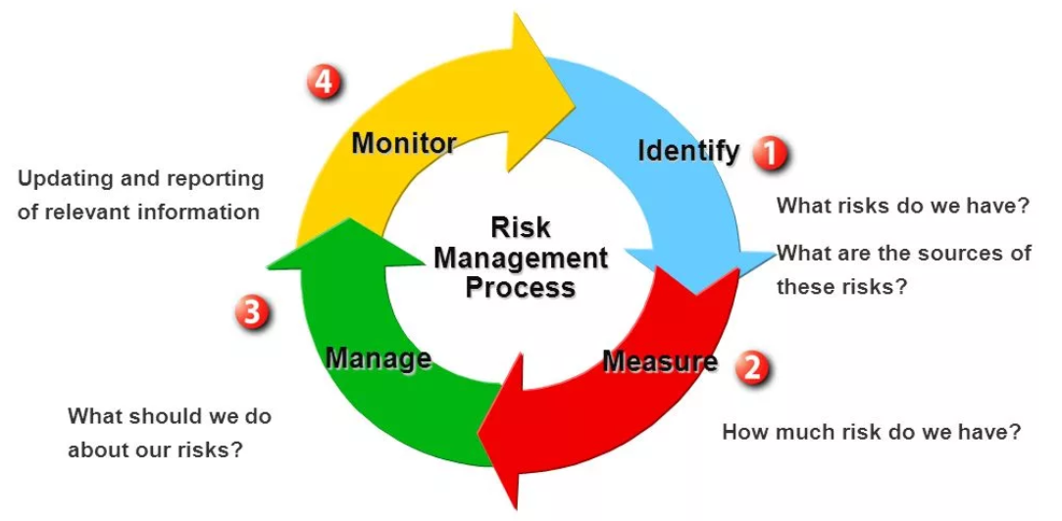
Risk management process

Slide 8
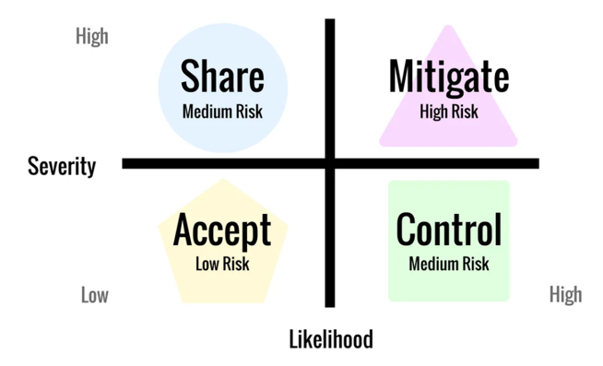
Components of risk and risk measurement
The probability that a risk event will occur during the predetermined period – likelihood
The impact or consequence of the event if it occurs – severity (the price you pay)
2. Measure
3. Manage

Slide 9
3. Manage: example of tools
Accept /not accept:
Model thresholds
Control:
Reporting
Share:
Insurance
Hedging
Mitigate:
Collateral
Covenants

Slide 10

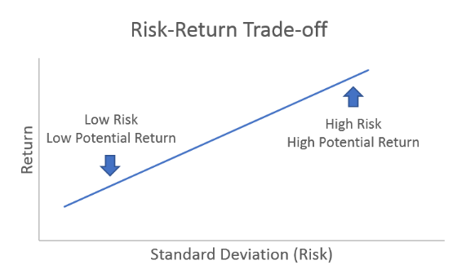
3. Manage: Risk-Return Trade-off

Slide 11
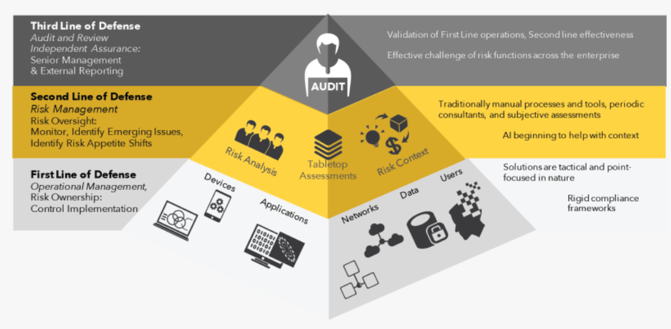

Lines of defense

Slide 12
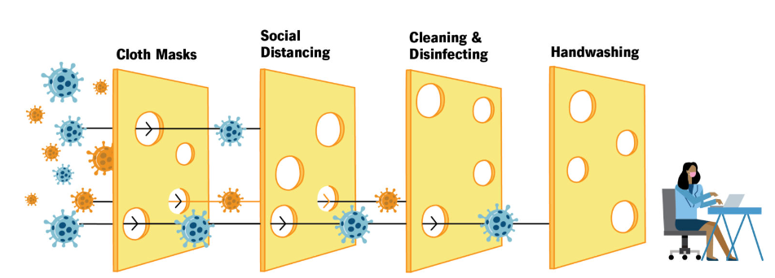
Swiss cheese model

Slide 13

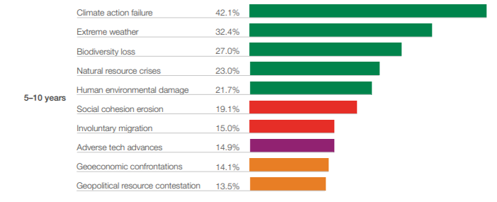
Global risk report

Slide 14
1.2 Foundations of risk management
IE 1.0
Foundations of accounting in bank

Slide 15
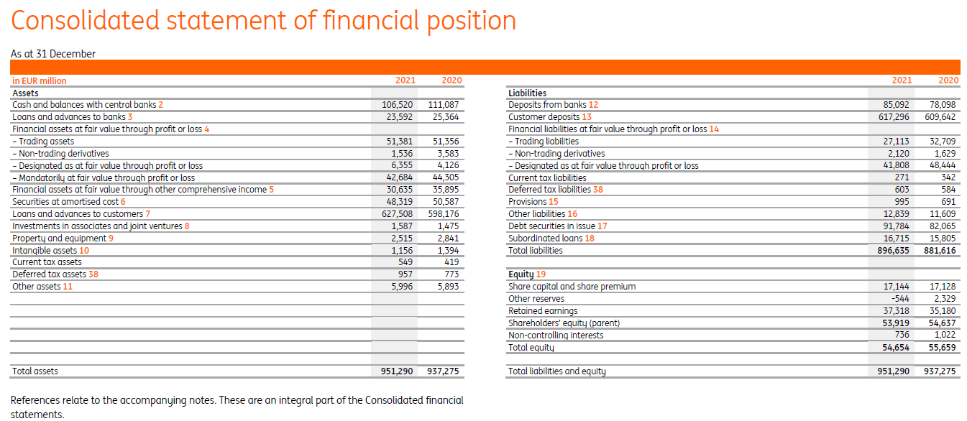
Balance sheet of the Bank

Slide 16
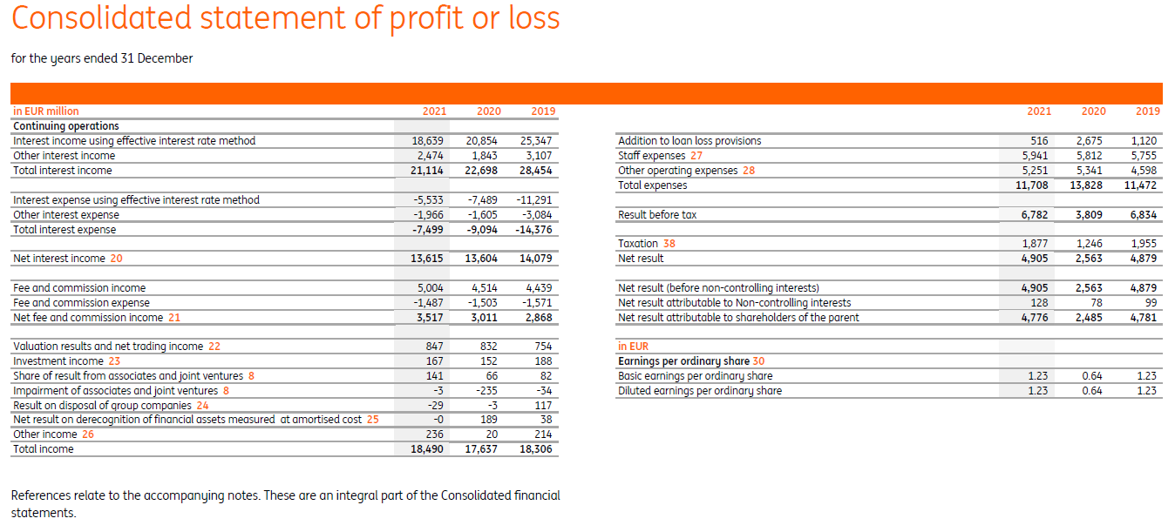
P&L of the Bank

Slide 17
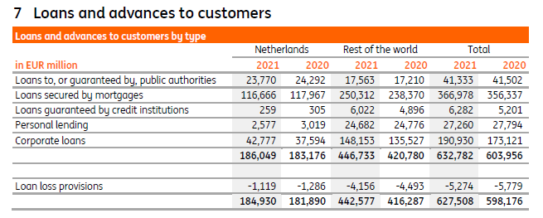
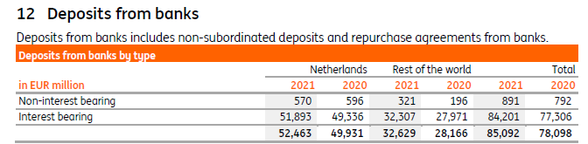
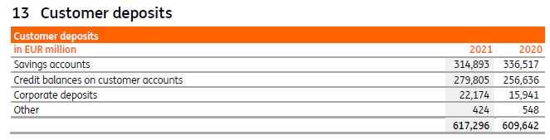
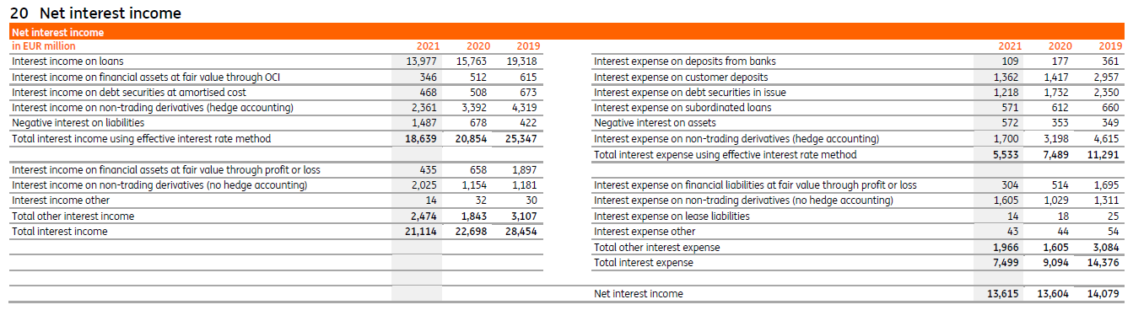
Main disclosures

Slide 18
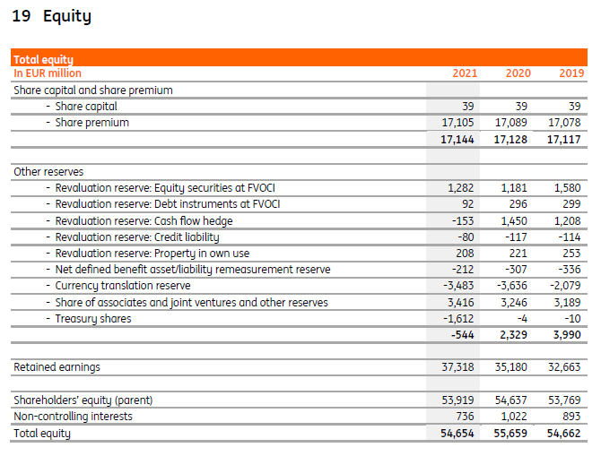
Capital of the Bank
Events affecting capital of the Bank:
Sum of all incomes, revaluations, provisions and costs => retained earnings
Dr Loans | Cr Interest income (interest accrued)
Dr Addition to loan loss provisions | Cr Loans (recognition of credit risk on the loans)
Dr FV of securities | Cr Income on revaluation (increase of the Fair value of securities in banking’s portfolio)

Slide 19
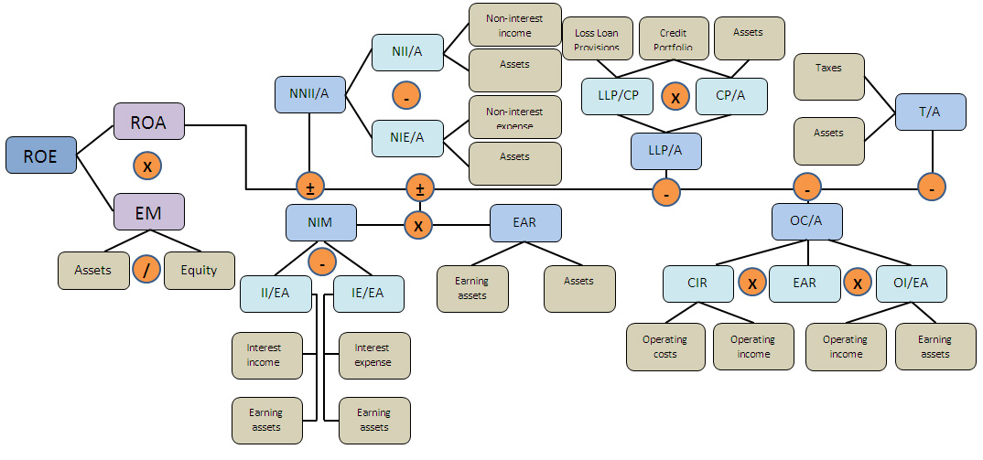
ROE tree – useful framework for financial analysis of the bank
IE 1.3

Slide 20
1.3 Foundations of risk management
Practical application of risk management in banking

Slide 21
Risk management level
Subject | Macroprudential level | Entity level
Objective | Limit financial system-wide distress: Protect consumers Prevent bank runs Minimize systemic risk | Limit distress of individual institution: Minimize losses Prevent bankruptcy
Instruments of Risk management | Basel I, II, III Reserve requirements Deposit insurance Banking product regulation* | Share Mitigate Accept Control
*absence of “fine print”, indication of effective interest rate of the loan, limitation of collection procedures and many others

Slide 22
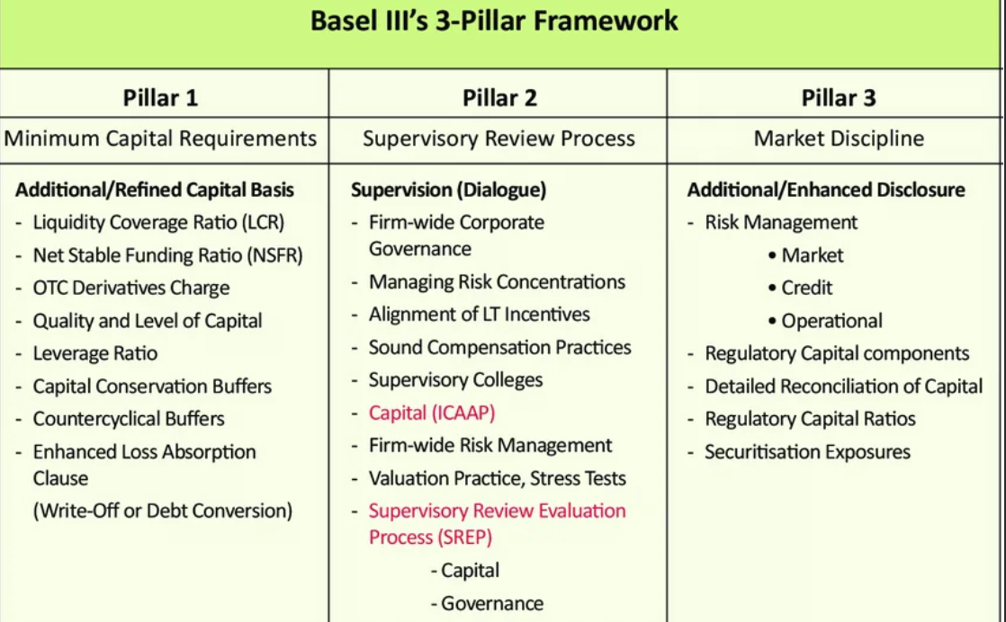
Basel

Slide 23
Banking business under Basel requirements
Regulatory limitation
Capital requirements
Liquidity and interest
rate risk requirements
Strategy and market limitation
Maximization of the profit
Market risk requirements
Internal limits
Potential of the Market

Slide 24
Basel Pillar I and II – CAR (Capital adequacy ratio) vs ICAAP (internal capital adequacy assessment process)
CAR (mandatory Ratio) $=\frac{Total capital}{Credit risk+Market risk+Operational risk}$ ⩾ 8%*
 | CAR | ICAAP
Calculation methodology | Predetermined by the regulator | At the bank's choice
Covered risks | Credit risk Market risk Operational risk | Credit risk Market risk Operational risk All other significant risks
Name of denominator | Regulatory capital | Economical capital (ECAP)
* On practice a bit more complex logic of ratios

Slide 25
Sanctions which Regulator can apply to local banks (law N 86)
Fine up to 1% of charter capital;
Demand from the bank:
to implement measures for the financial rehabilitation of a credit institution, including changes in the structure of its assets;
to change top management;
to limit remuneration to top management
Ban particular banking operations;
Assign transitional administration;
5. Ban reorganization;
6. Demand additional capitalization;
7. Limit interest rate on attracted funds.

Slide 26
Basel Pillar II – risk appetite framework
Bank defines Risk Appetite Framework (RAF) - set numerical thresholds on risk metrics for each significant risk;
Such thresholds should be approved by the Board of directors and acknowledged by the Local regulator;
There are 3 types of thresholds for each metric:
green – ok, nothing to. For instance CAR 10%
yellow – if breached, the Board of directors should be informed and plan for normalization should be developed. For instance CAR 9%
red – if breached, the Regulator should be informed and Bank obliged to reconsider business plan and conduct immediate actions in order to normalize the situation. CAR 8.5%

Slide 27
Basel Pillar II – Stress testing
Types of regulatory ST (RRP, ICAAP, SREP EU wide stress tests and etc)
Steps of stress testing:
Scenario:
Top-down or bottom-up;
Severity (harm, duration);
Other features of the stress
Scope:
Exposure (whole bank, business block, branch, product);
Types of risks
Modeling the impact of scenarios on risk parameters
Modeling of exposure at risk:
Dynamic balance sheet (DBS)
Static balance sheet (SBS)
Calculate stressed key performance indicators:
CAR
Liquidity
P&L
Reporting and disclosure
Management actions

Slide 28
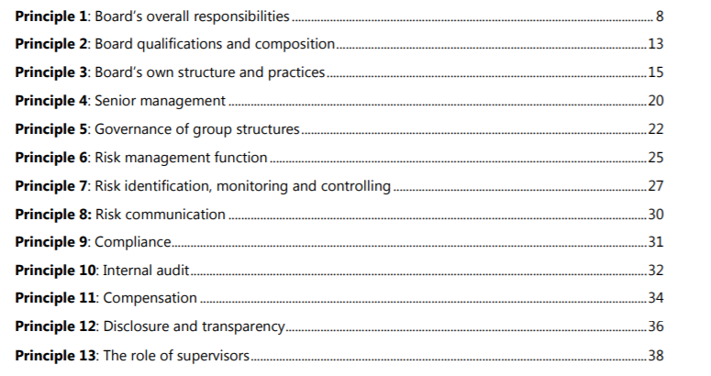
Basel Pillar II – Corporate governance (1/3)
IE1.5
BCBS 328

Slide 29
Basel Pillar II – Corporate governance (2/3)
IE1.5
Principle 1: Board’s overall responsibilities
The board has overall responsibility for the bank, including approving and overseeing management’s implementation of the bank’s strategic objectives, governance framework and corporate culture.
Principle 2: Board qualifications and composition
Board members should be and remain qualified, individually and collectively, for their positions. They should understand their oversight and corporate governance role and be able to exercise sound, objective judgment about the affairs of the bank.
Principle 3: Board’s own structure and practices
The board should define appropriate governance structures and practices for its own work, and put in place the means for such practices to be followed and periodically reviewed for ongoing effectiveness.
Principle 4: Senior management
Under the direction and oversight of the board, senior management should carry out and manage the bank’s activities in a manner consistent with the business strategy, risk appetite, remuneration and other policies approved by the board.
Principle 5: Governance of group structures
In a group structure, the board of the parent company has the overall responsibility for the group and for ensuring the establishment and operation of a clear governance framework appropriate to the structure, business and risks of the group and its entities.
Principle 6: Risk management function
Banks should have an effective independent risk management function, under the direction of a chief risk officer (CRO), with sufficient stature, independence, resources and access to the board.

Slide 30
Basel Pillar II – Corporate governance (3/3)
IE1.5
Principle 7: Risk identification, monitoring and controlling
Risks should be identified, monitored and controlled on an ongoing bank-wide and individual entity basis. The sophistication of the bank’s risk management and internal control infrastructure should keep pace with changes to the bank’s risk profile, to the external risk landscape and industry practice.
Principle 8: Risk communication
An effective risk governance framework requires robust communication within the bank about risk, both across the organisation and through reporting to the board and senior management.
Principle 9: Compliance
The bank’s board of directors is responsible for overseeing the management of the bank’s compliance risk. The board should establish a compliance function and approve the bank’s policies and processes for identifying, assessing, monitoring and reporting and advising on compliance risk.
Principle 10: Internal audit
The internal audit function should provide independent assurance to the board and should support board and senior management in promoting an effective governance process and the long-term soundness of the bank.
Principle 11: Compensation
The bank’s remuneration structure should support sound corporate governance and risk management.
Principle 12: Disclosure and transparency
The governance of the bank should be adequately transparent to its shareholders, depositors, other relevant stakeholders and market participants

Slide 31
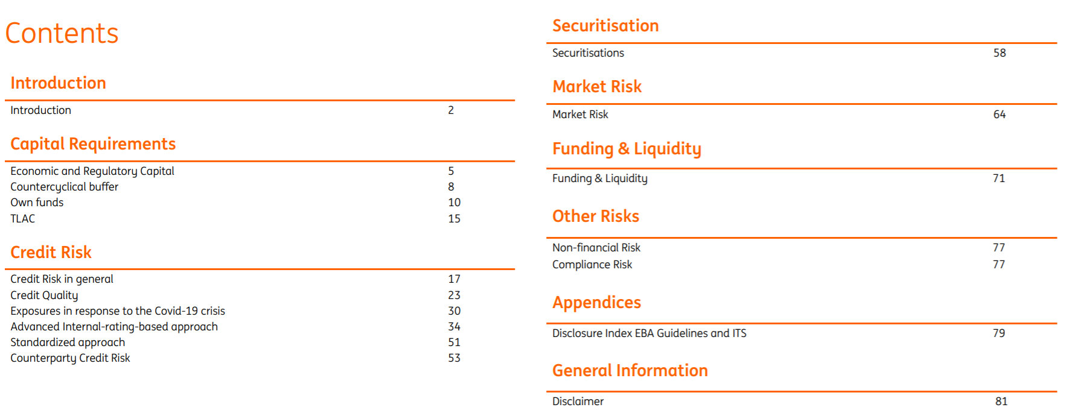
Basel Pillar III - Disclosure

Slide 32
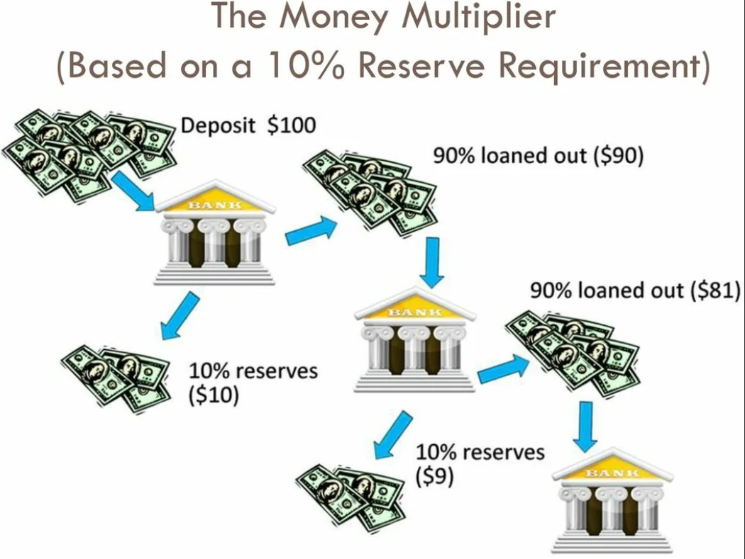
Reserve requirements
Banks obliged to freeze a percentage of deposits as reserves in a Central bank account = > Dr Balance with central bank | Cr Cash
Balance with central bank = deposit * coefficient based on the type of deposit*
So, to grant a 100 rub loan, a bank needs to attract a 104.2 (=100/0.96) rub deposit
*4% for deposits in rubles, 8% for deposits in FX

Slide 33
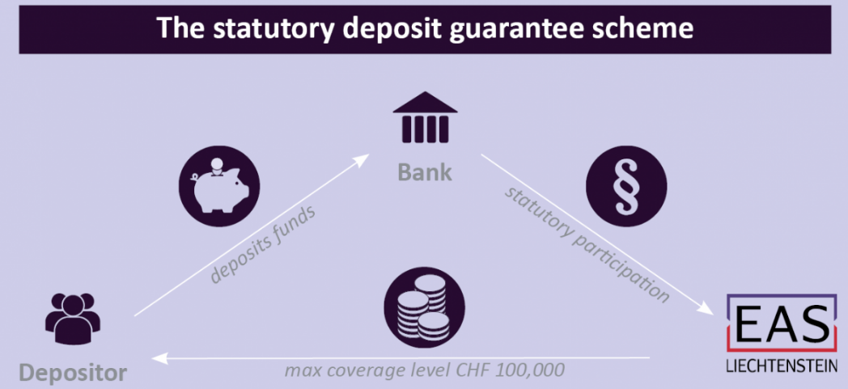

Deposit insurance
Banks obliged to pay for deposit insurance = > Dr Charge of insurance premium (Loss) | Cr Cash
Quarterly charge of insurance premium = simple average of deposits (retail and corporate) * 0.12%
Coverage level in Russia for retail and corporate => 1.4 mln.rub. In particular cases may be increased up to 10 mln.rub.
State insurance agency
*Actual on 03.08.2022 for all types of deposits

Slide 34
Moral Hazard
Moral hazard is a term used in economics and finance to describe a situation where one party is willing to take more risk because they know that the negative consequences of that risk will be borne, at least partially, by another party.
In the context of banking, moral hazard can occur in various ways. Here are a couple of examples:
Bank Bailouts: If banks believe they are 'too big to fail' and expect government bailouts in case of financial trouble, they might be encouraged to engage in riskier behavior than they would if they had to bear all the consequences of their actions. This is because they know that if their bets pay off, they reap the benefits, but if they don't, the taxpayers will shoulder the cost. This was a key issue during the 2007-2008 global financial crisis.
Loan Guarantees: Moral hazard can also occur when loans are guaranteed, for example, by a government agency. In this case, lenders might be willing to make riskier loans than they would otherwise. If the borrower defaults, the guaranteeing agency (and ultimately the taxpayer) would bear the cost, not the lender. This might lead to a lack of proper diligence on the part of the lender when evaluating the creditworthiness of the borrower.
Deposit Insurance: Similarly, deposit insurance schemes can create a moral hazard issue. If a bank knows that its deposits are insured, it might feel encouraged to make riskier investments because it knows that even if these investments fail, the depositors will still get their money back from the insurance. This could lead to a situation where banks take excessive risks.
Dubious motivation of hedge funds remuneration (GPT can give an example)
The challenge with moral hazard is to create a balance between providing necessary protections (like deposit insurance and potential bank bailouts) and ensuring that these protections do not encourage reckless behavior. Policymakers often attempt to manage this balance through regulatory oversight and mechanisms such as capital adequacy requirements.

